Slide 1
Ajax on Rails
Igor Kasyanchuk

Slide 2
Agenda
What is Ajax
Javascript libraries
jQuery
Prototype
Other
Ruby on Rails and Ajax
Unobtrusive scripting
Tools and Libraries
Sample
Links
Questions and Answers

Slide 3
What is Ajax
Ajax is a group of interrelated web development techniques used on the client-side to create asynchronous web applications.
With Ajax, web applications can send data to, and retrieve data from, a server asynchronously (in the background) without interfering with the display and behavior of the existing page.

Slide 4
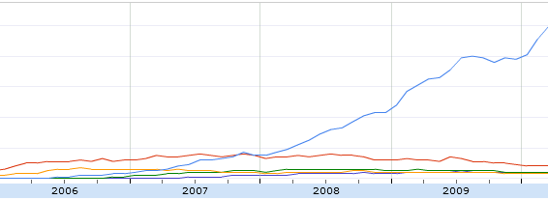
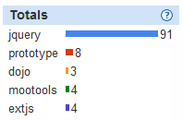
Javascript Libraries

Slide 5
jQuery
jQuery Sample
$("p.slogan").addClass("ohmy").show("slow");
jQuery Ajax Sample
$.ajax({
url: "test.html",
context: document.body,
success: function() {
$(this).addClass("done");
}
});
http://api.jquery.com/category/ajax/

Slide 6
Prototype
Sample
$('target').addClassName('highlighted');
Prototype Ajax Sample
new Ajax.Request ('/your/url', {
onSuccess: function(response) {
// Handle the response content...
}
});

Slide 7
Other
YUI http://developer.yahoo.com/yui/
Sencha (Ext JS) http://www.sencha.com/
Dojo http://dojotoolkit.org/

Slide 8
Ruby on Rails and Ajax - 1
How it was
Ruby on Rails 1.x
Ruby on Rails 2.x
What we have now
Future
Render HTML form in JavaScript with jQuery HTML builder nodes
Use a template system like Mustache.js or Handlebars.js
Use a JavaScript [client-side] Model-View framework like Backbone.js

Slide 9
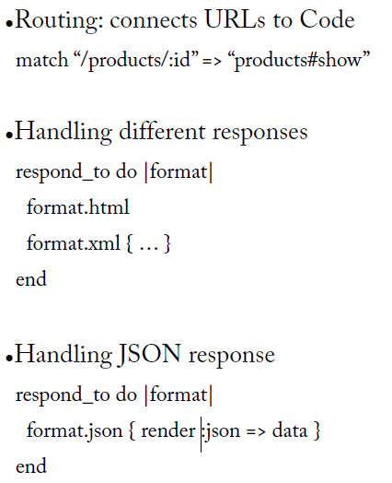
Ruby on Rails and Ajax - 2

Slide 10
Ruby on Rails and Ajax - 3
Sample
<%= link_to "delete", domain_path(@domain), :method => :delete, :confirm => "Are you sure?“ %>
Old-way
<a href="/domains/1" class="destroy" onclick="if (confirm('Are you sure?')) { var f = document.createElement('form'); f.style.display = 'none'; this.parentNode.appendChild(f); f.method = 'POST'; f.action = this.href;var m = document.createElement('input'); m.setAttribute('type', 'hidden'); m.setAttribute('name', '_method'); m.setAttribute('value', 'delete'); f.appendChild(m);var s = document.createElement('input'); s.setAttribute('type', 'hidden'); s.setAttribute('name', 'authenticity_token'); s.setAttribute('value', 'pKvg9hsnQ33uk='); f.appendChild(s);f.submit(); };return false;">delete </a>
New-way
<a href="/domains/1" data-confirm="Are you sure?" data-method="delete" rel="nofollow">delete</a>

Slide 11
Ruby on Rails and Ajax - 4
In Controller:
def show
respond_to do |page|
page.html {}
page.js
end
end
Views:
Show.js.coffee
alert ‘hello world’
Useful method (in controller):
request.xhr?

Slide 12
Unobtrusive Javascript
The implementation of Unobtrusive JavaScript, and the consequent removal of the old inline AJAX commands, offers at least three advantages:
Less verbose, inline, behavior code in the HTML document, with the result of much more lightweight, cleaner and readable source code.
Rails 3 is no longer Prototype-oriented. With Rails 3 you can easily switch from a JavaScript framework to an other.
Rails 3 code is now JavaScript framework agnostic. It no longer contains framework-specific commands or scripts.

Slide 13
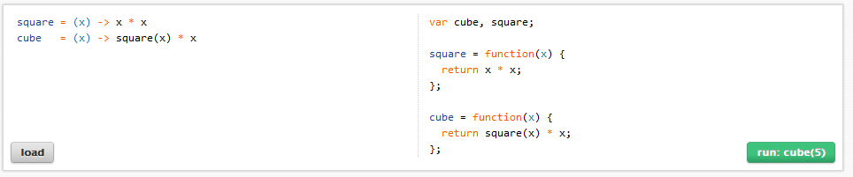
Tools and Libraries
Ruby
Ruby on Rails
Web Developer Tools (Chrome, FF)
CoffeeScript

Slide 14
Sample
Let’s do a simple Ajax page from scratch.

Slide 15
Useful links
http://api.jquery.com/category/ajax/
http://railscasts.com/episodes/205-unobtrusive-javascript
http://www.simonecarletti.com/blog/2010/06/unobtrusive-javascript-in-rails-3/
http://jquery.com/
http://coffeescript.org/
http://heroku.com
And others ….

Slide 16


Questions?

Slide 17


